Slide 1

OOPS USING JAVA Course Code – R1UC201C COURSE BASED PROJECT TITLE – BANK MANAGEMENT SYSTEM Sem-II (Session – 2024-25)
TEAM MEMBERS:-
DIVYANSHU AGRAWAL (24SCSE1410118)
ISHITA DUBEY (24SCSE1410264)
MANTHAN (24SCSE1410173)
RIYA RAJ (24SCSE1410241)

Slide 2
INTRODUCTION
Bank is the place where customers feel the sense of safety for their property. In the bank, customers deposit and withdraw their money.
Transaction of money also is a part where customer takes shelter of the bank. Now to keep the belief and trust of customers, there is the positive need for management of the bank, which can handle all this with comfort and ease. Smooth and efficient management affects the satisfaction of the customers and staff members, indirectly.
And of course, it encourages management committee in taking some needed decision for future enhancement of the bank. Now a days, managing a bank is tedious job upto certain limit. So, a bank management system that reduces the work is essential. Also today’s world is a genuine computer world and is getting faster and faster day-by-day.
Thus, considering above necessities, the system for bank management has became necessary which would be useful in managing the bank more efficiently.

Slide 3
PROBLEM STATEMENT
The Bank Management system consists of the bank administrator and the customer. The administrator will need to create a new account for the customer by logging into their existing account.
For creating a new account on the system the administrator will need to enter details of customer like first name, last name, address, contact no and will add the branch where the account has been created.
The system executes operations like creating new account, checking the balance of the account, withdrawing, depositing, money transfers between two accounts and viewing transaction history.

Slide 4
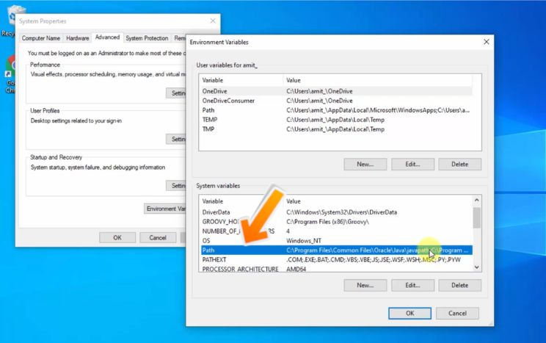
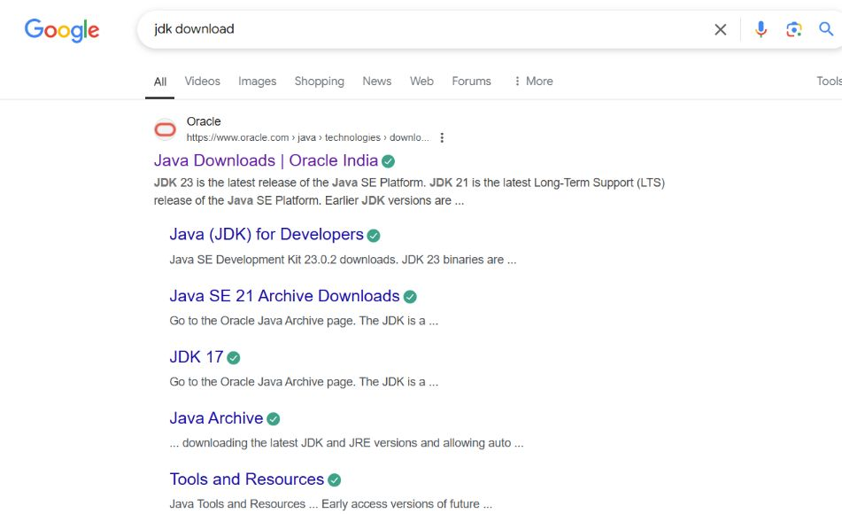
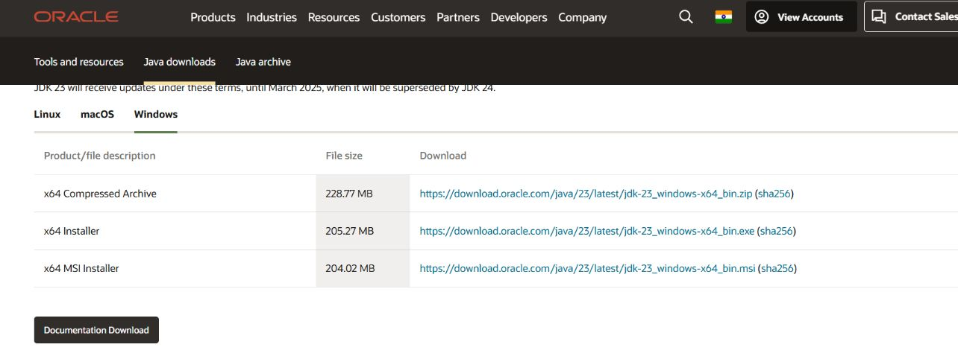
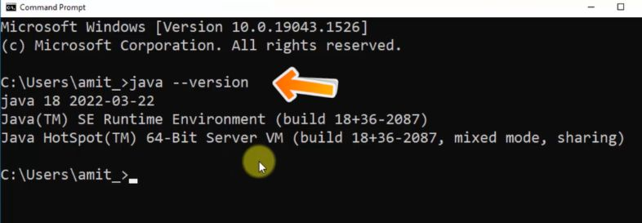
Install JDK

Slide 5
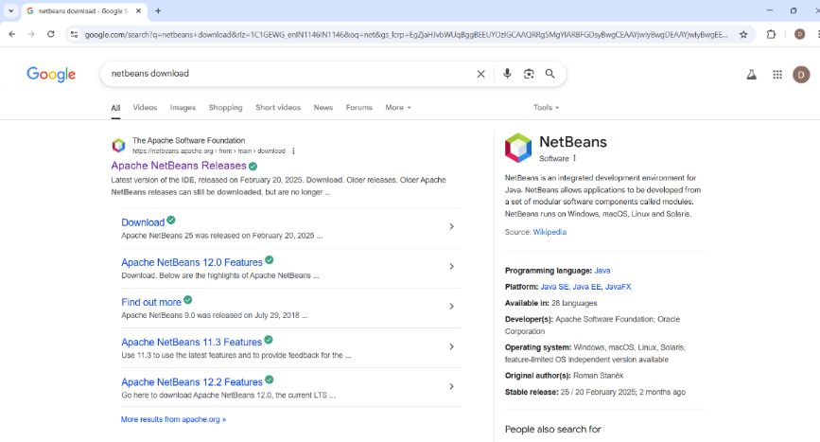
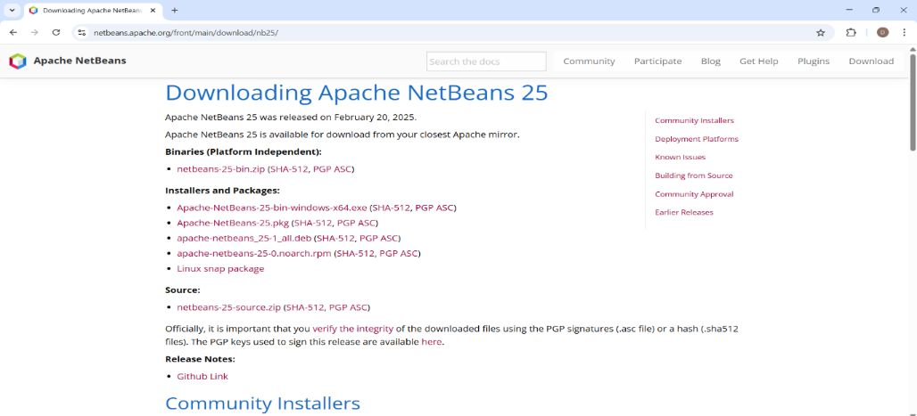

INSTALL IDE(NETBEANS)

Slide 6
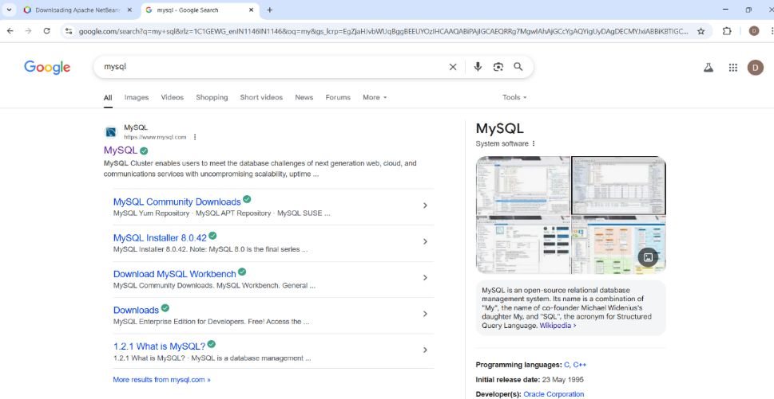
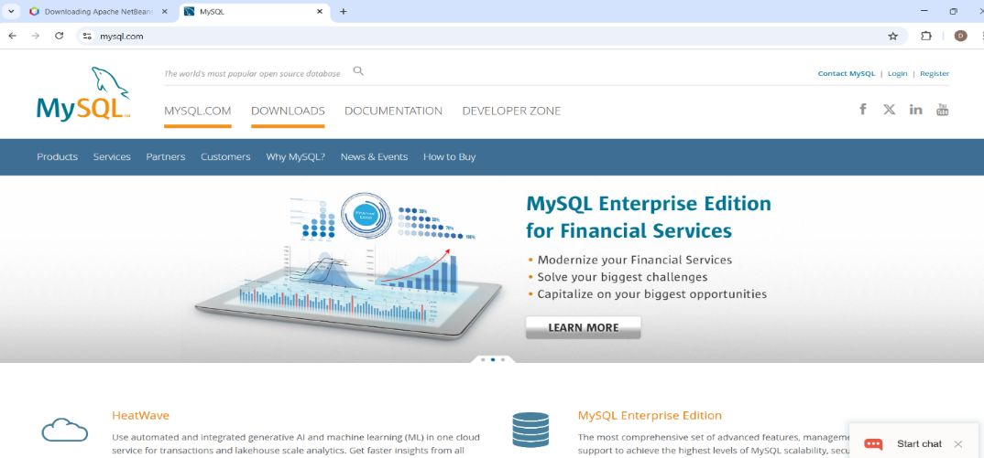
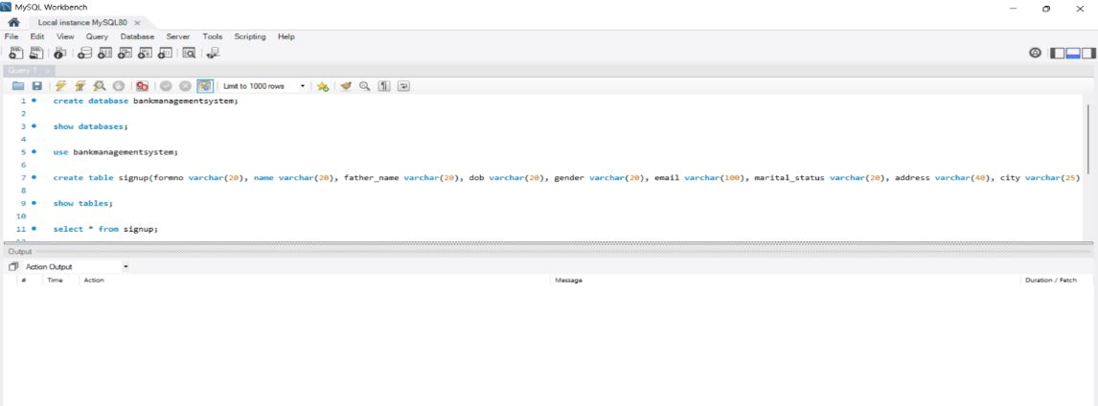
INSTALL MYSQL

Slide 7
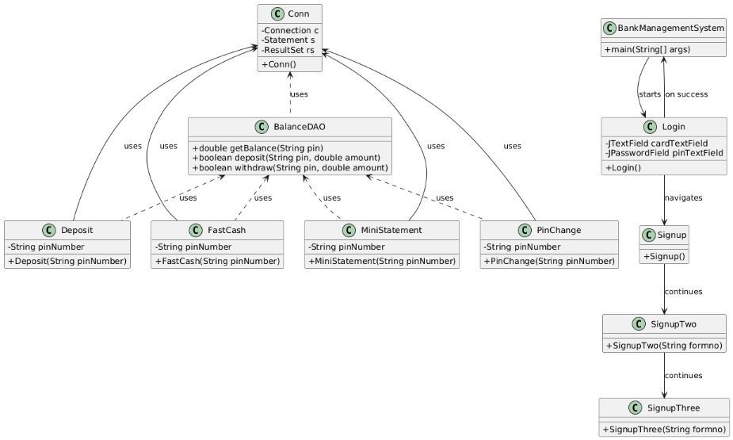
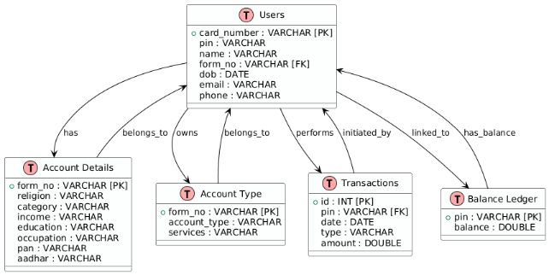
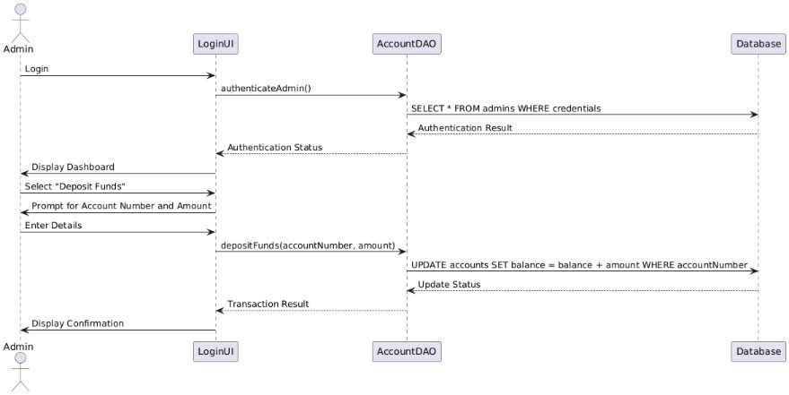
PROJECT STRUCTURE

Slide 8
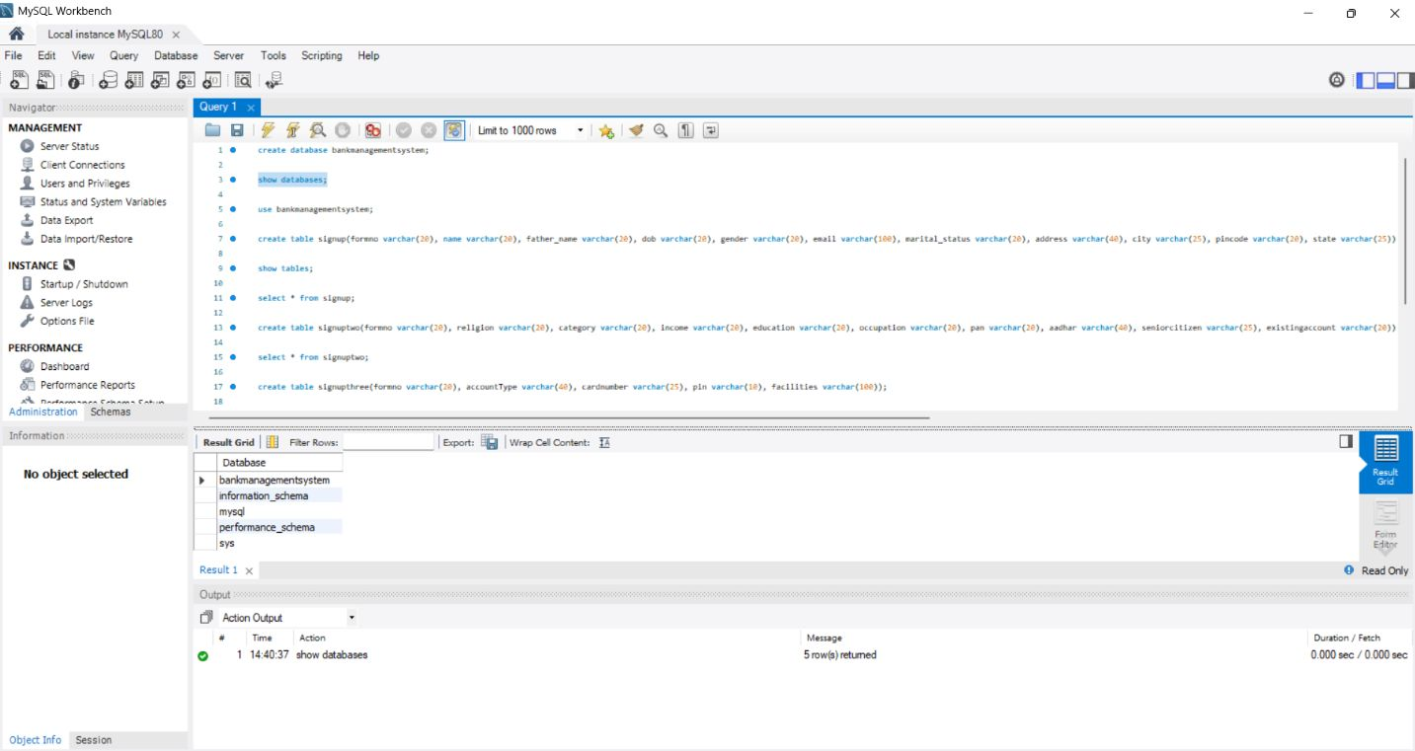
Design the Database Schema for the Project Database schema appears to have a relational design with three core tables for user authentication, transactions, and signup data. The schema supports multiple banking operations by linking transactions to users via PINs.

Slide 9
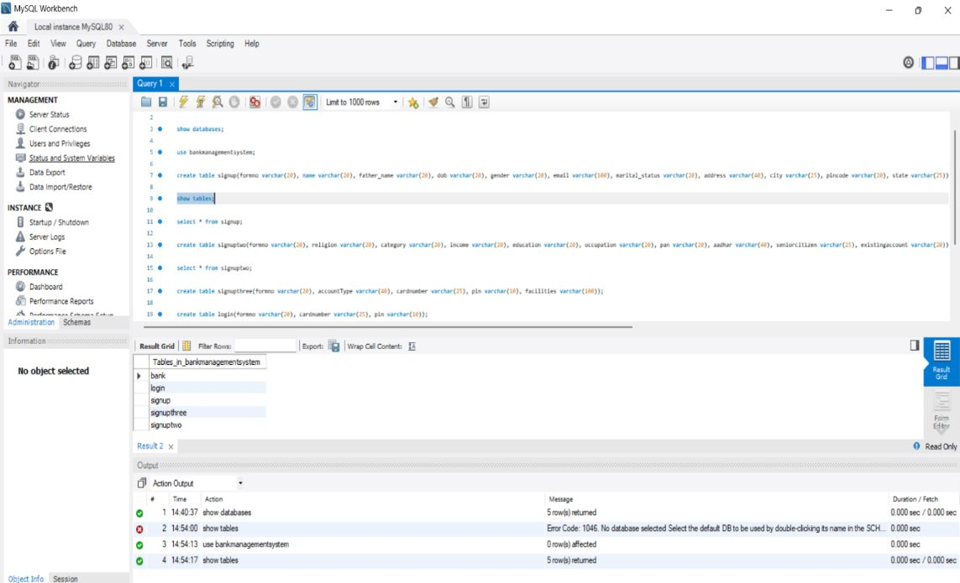
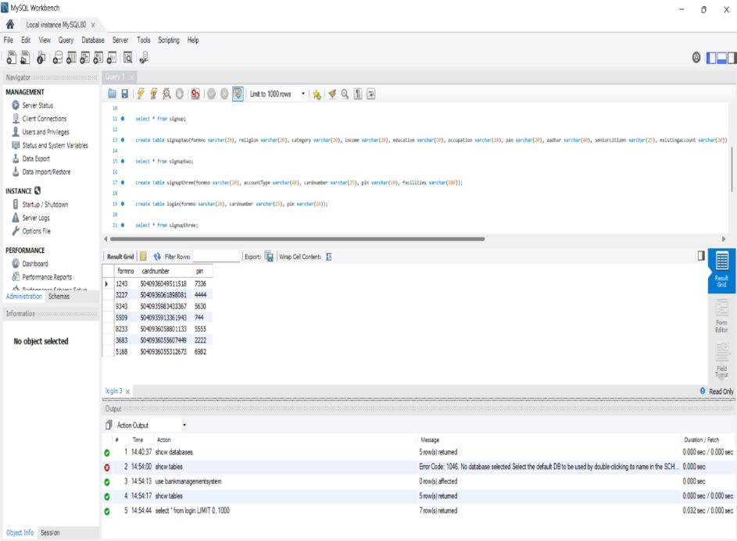
Create a MySQL Table MySQL tables exist as the project successfully performs queries like without error handling for missing tables. We’ve implicitly created tables that handle users, transactions, and signup info.
conn = DriverManager.getConnection("jdbc:mysql://localhost:3306/bankmanagementsystem", "root", "Divyan@2006");

Slide 10
Implement JDBC for Database Connectivity
JDBC is used effectively to connect, query, and update the MySQL database. Connection and statement objects are managed well, ensuring database interaction across UI and DAO layers.
Class.forName("com.mysql.cj.jdbc.Driver");
conn = DriverManager.getConnection("jdbc:mysql://localhost:3306/bankmanagementsystem", "root“,"Divyan@2006")
Statement s = conn.createStatement();

Slide 11
Create Model, DAO Classes for Database Operations
DAO Class | Main Responsibility | Core Operations
UserDAO | User authentication & credentials | Login, Signup, PIN update
BalanceDAO | Account balance calculation | Fetch transactions, sum deposits/withdrawals
TransactionDAO | Transaction recording & history | Insert transaction, fetch mini statement

Slide 12
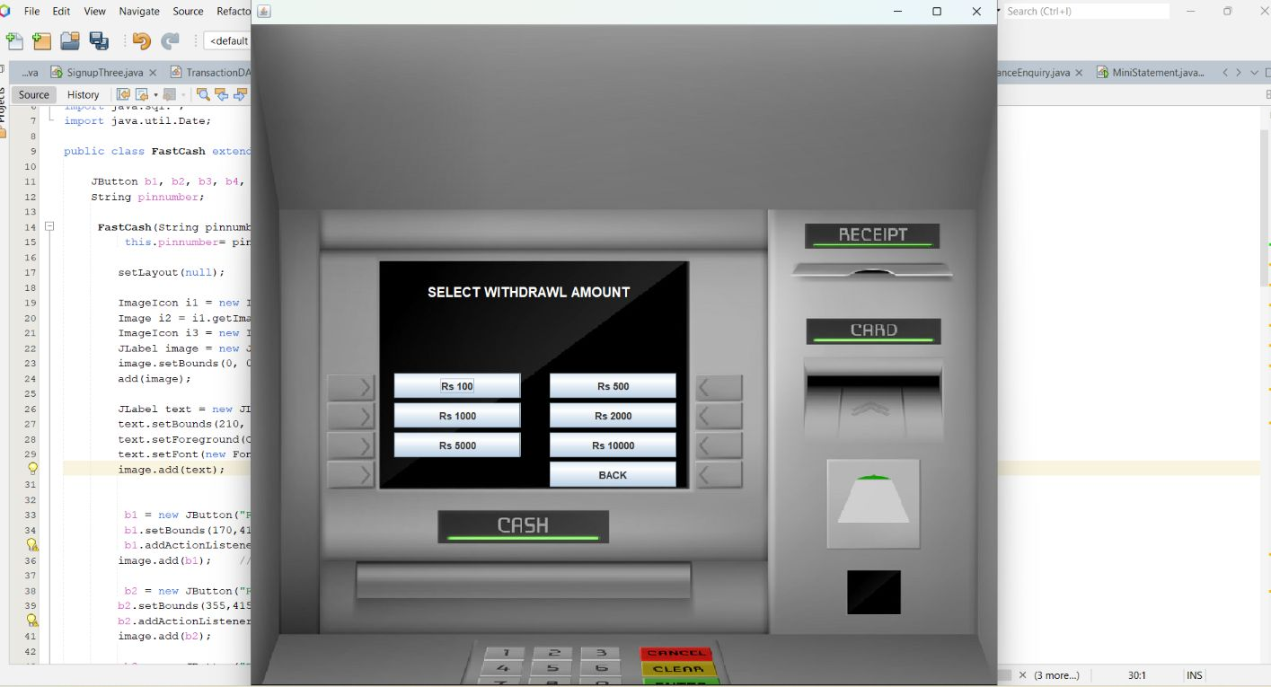
Aesthetics and Visual Appeal of the UI
Background Image: Uses a full-size ATM background image (atm.jpg) which gives a professional and realistic banking feel.
Text Styling: The headings is styled with a bold font, set in white, and positioned clearly on the background.
Button Design & Layout: Buttons for fixed withdrawal amounts are well spaced and aligned in a grid-like manner with consistent sizes, making it easy and intuitive for users to select amounts.
Color Contrast:
White text and buttons placed on a darker ATM image create good contrast for readability.

Slide 13
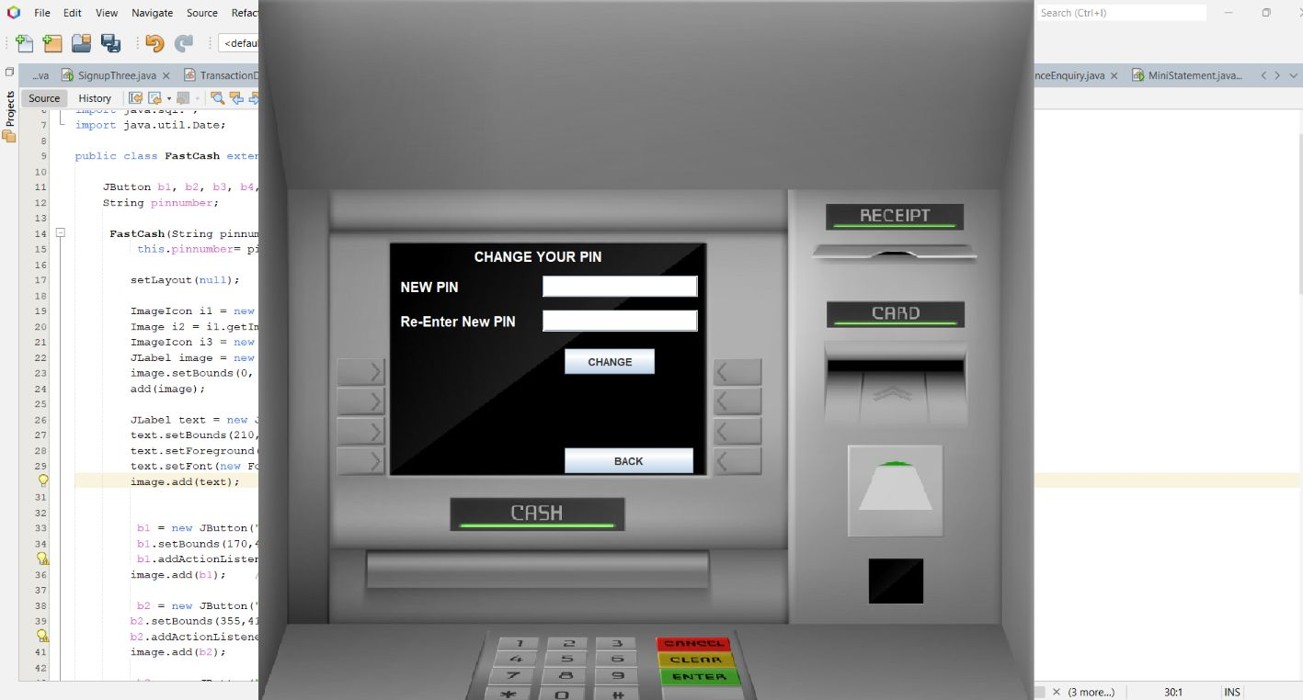
Component Placement and Alignment in the UI
Logical Grouping: The labels (NEW PIN,Re-Enter New PIN) and their corresponding input fields (JPasswordField) are aligned vertically with consistent spacing.
Clear Label-Input Association: Each label is placed immediately to the left of the input field, making it visually clear
Button Placement: The CHANGEandBACKbuttons are aligned horizontally at appropriate positions for easy access.
Consistent Margins and Padding: Components have consistent bounds, and the layout is neat and balanced inside the window.

Slide 14
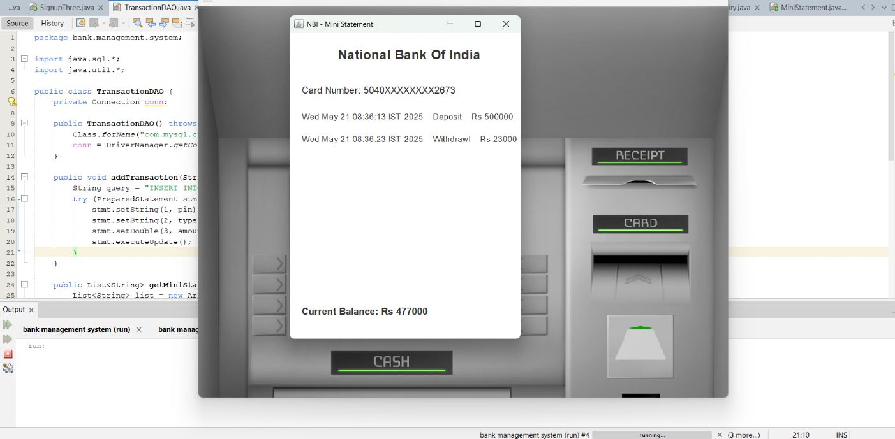
Responsiveness and Accessibility of the UI
No Fixed Background Image: Unlike other screens that use a fixed-size ATM background
image(which limits responsiveness), MiniStatementuses a
plain JFramewith a white background.
This makes it easier to resize and adapt to various
screen sizes.
Use of Scroll-friendly Label (HTML-formatted): The JLabeldisplaying transactions (mini) uses HTML formatting and verticalalignment, making it adaptable to longer text content.
Logical Layout Flow: The layout follows a top-down vertical order,
which improves accessibility (especially for screen readers).
Font and Color: Fonts are readable and the contrast (black text onwhite background) is excellent for accessibility.

Slide 15
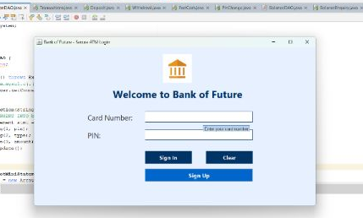
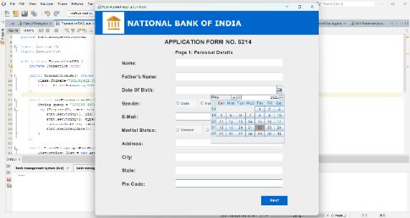
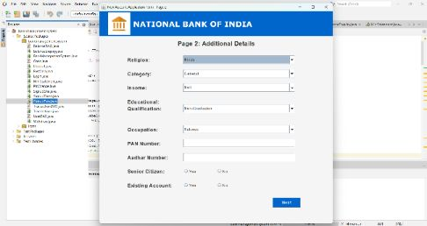
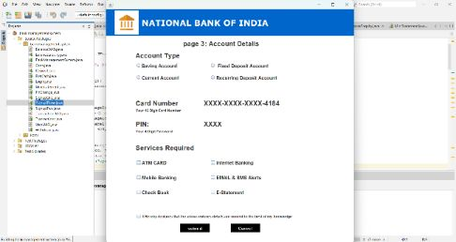
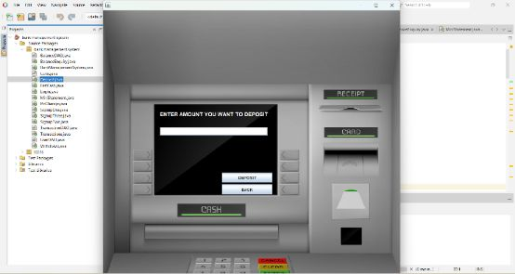
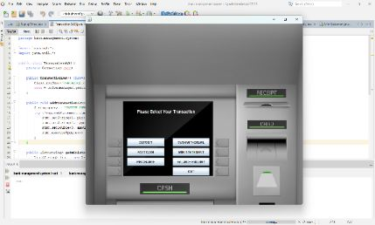
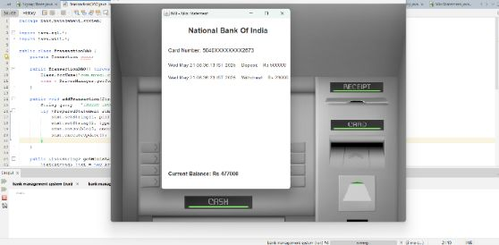
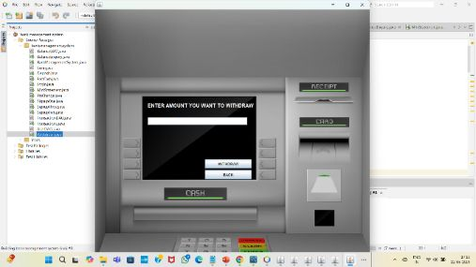
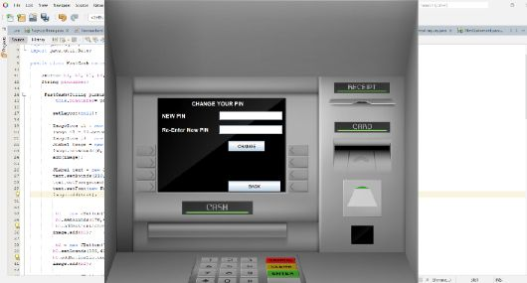
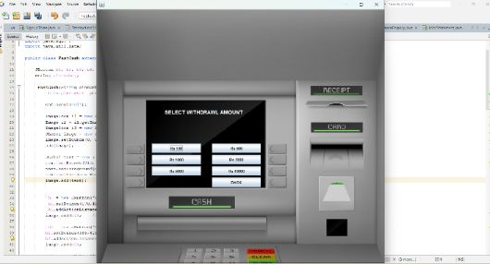
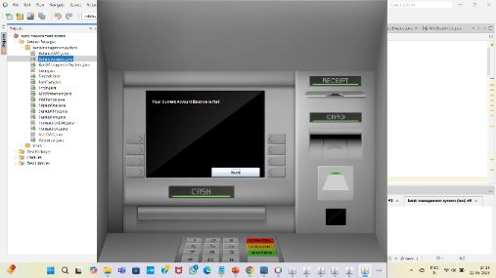
Sign up-1
Sign up-2
Sign up-3
Back to Login Page
Sign in to Transactions
Deposit
Mini Statement
Pin Change
Balance Enquiry
Withdraw
Fast Cash

Slide 16
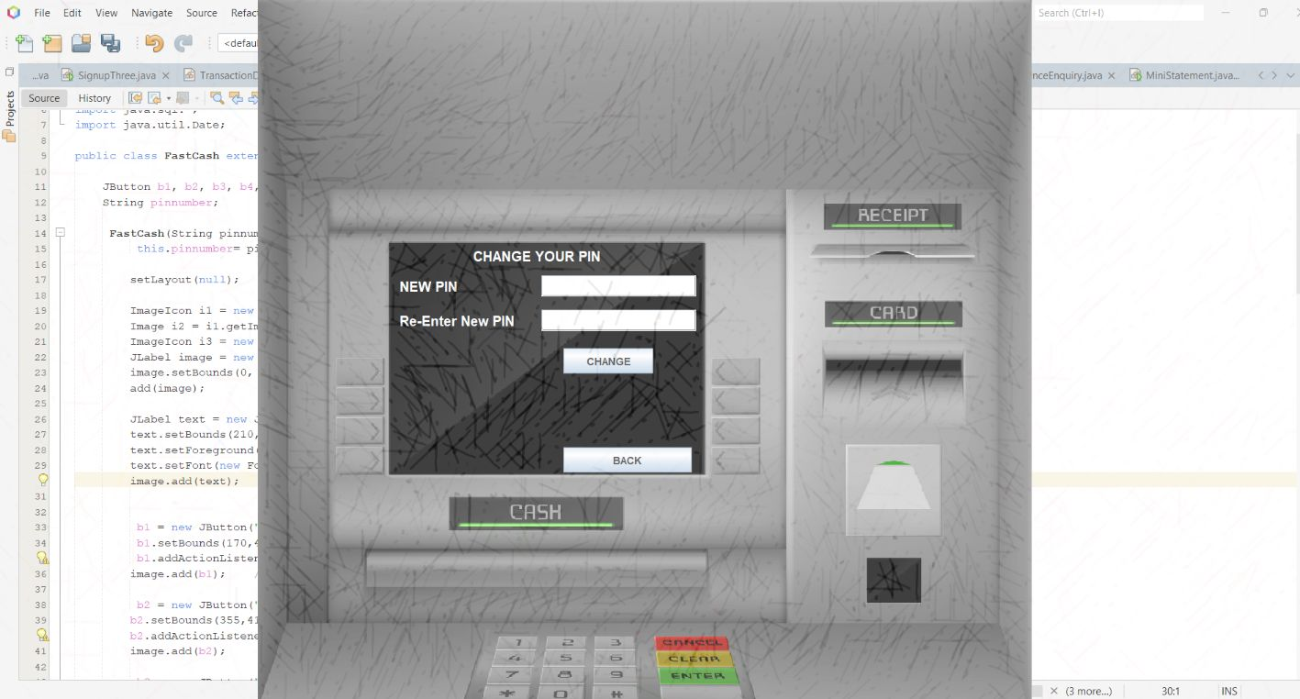
THANK YOU

